Slide 1

Customer personality analysis​
​
Objective : Customer Personality Analysis is a detailed analysis of a company’s ideal customers. It helps a business to better understand its customers and makes it easier for them to modify products according to the specific needs, behaviour and concerns of different types of customers.​
​
Target : Need to perform clustering to summarize customer segments.​
​

Slide 2
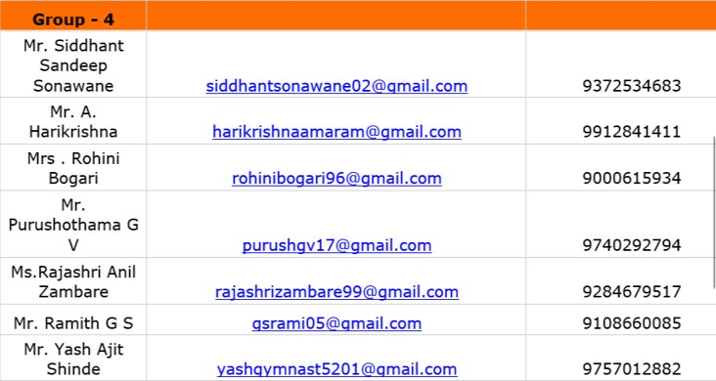
Group Members​

Slide 3
Attributes People ID: Customer’s unique identifier Year_Birth: Customer’s birth year Education: Customer’s education level Marital_Status: Customer’s marital status Income: Customer’s yearly household income Kidhome: Number of children in customer’s household Teenhome: Number of teenagers in customer’s household Dt_Customer: Date of customer’s enrollment with the company Recency: Number of days since customer’s last purchase Complain: 1 if customer complained in the last 2 years, 0 otherwise Products MntWines: Amount spent on wine in last 2 years MntFruits: Amount spent on fruits in last 2 years MntMeatProducts: Amount spent on meat in last 2 years MntFishProducts: Amount spent on fish in last 2 years MntSweetProducts: Amount spent on sweets in last 2 years MntGoldProds: Amount spent on gold in last 2 years Promotion NumDealsPurchases: Number of purchases made with a discount AcceptedCmp1: 1 if customer accepted the offer in the 1st campaign, 0 otherwise AcceptedCmp2: 1 if customer accepted the offer in the 2nd campaign, 0 otherwise AcceptedCmp3: 1 if customer accepted the offer in the 3rd campaign, 0 otherwise AcceptedCmp4: 1 if customer accepted the offer in the 4th campaign, 0 otherwise AcceptedCmp5: 1 if customer accepted the offer in the 5th campaign, 0 otherwise Response: 1 if customer accepted the offer in the last campaign, 0 otherwise Place NumWebPurchases: Number of purchases made through the company’s web site NumCatalogPurchases: Number of purchases made using a catalogue NumStorePurchases: Number of purchases made directly in stores NumWebVisitsMonth: Number of visits to company’s web site in the last month

Slide 4
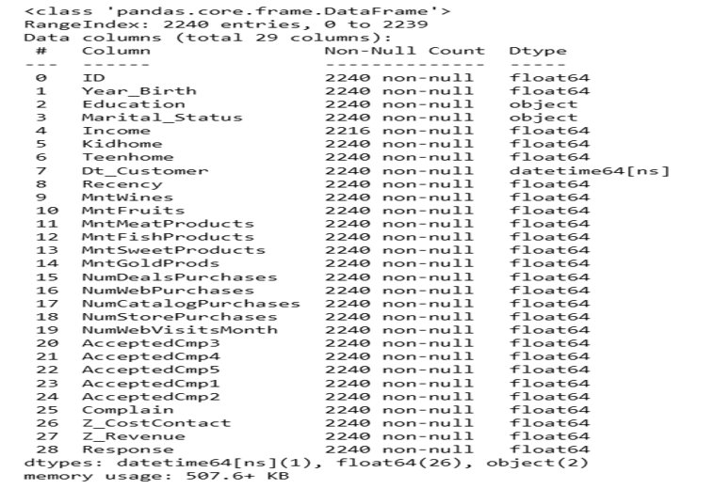
Exploratory Data Analysis​
Data Set Details: ​

Slide 5
Observations
1. Data contains 2240 rows and 29 columns
2. It has 1 float, 3 object and 25 int columns
3. Datetime columns have int datatype, need to fix that
4. Many categorical columns are alredy in int format, like AcceptedCmp1, Response
5. There are 24 missing values in Income column
6. There are no duplicate values within data

Slide 6
FEATURE CONSTRUCTION
* Create `Age`,`Years_Customer` and `Days_Customer` columns by substracting last date of `Dt_Customer` from `Year_Birth` and `Dt_Customer`
* Create `TotalMntSpent`,`TotalNumPurchases` and `TotalAccCmp` by adding the relative columns
* Create `Year_Joined`,`Month_Joined` and `Day_Joined` columns through `dt_Customer`
* Create `Age_Group` column by dividing `Age` column into different groups
* Create `Children` column by adding `Kidhome` and `Teenhome` columns
* Create `Partner` and `Education_Level` for simplifying `Marital_Status` and `Education` columns
* Drop the redundant columns

Slide 7
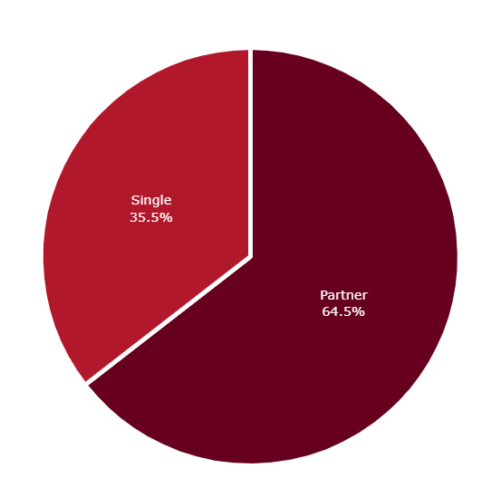
Marital Status
2/3 of customers live with a partner while about 1/3 are single

Slide 8
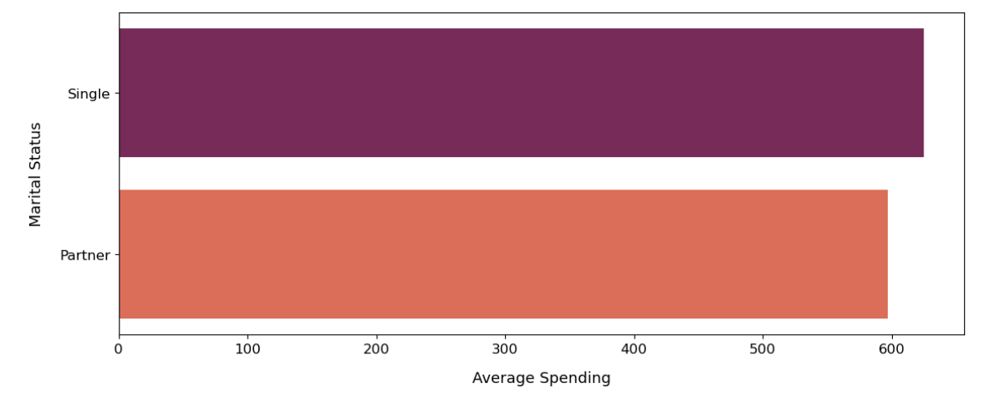
Average Spendings: Marital Status Wise

Slide 9
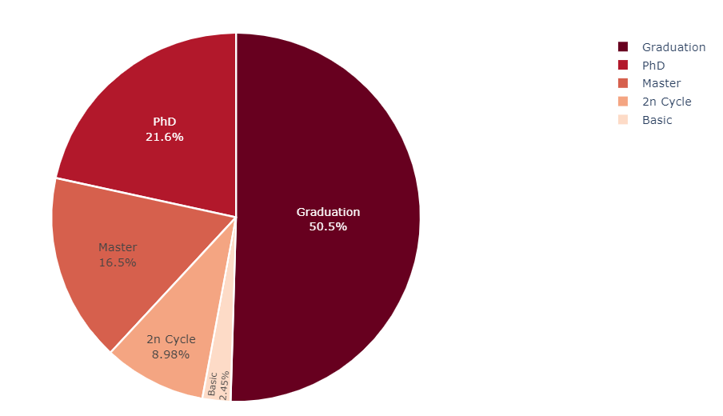
Education Level
- Half of the customers are University graduates
- There are more customers with PhD degrees than customers with Master's degrees

Slide 10
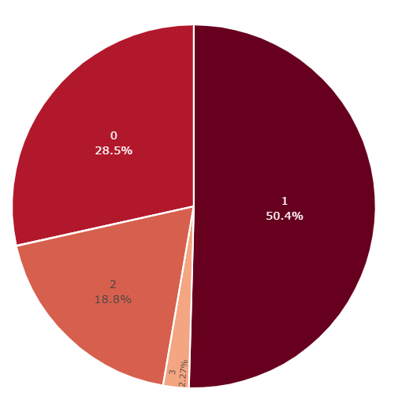
Child Status
- About 50% of customers have only one child
- 28% of customers do not have children at home while 19% of them have 2 children

Slide 11
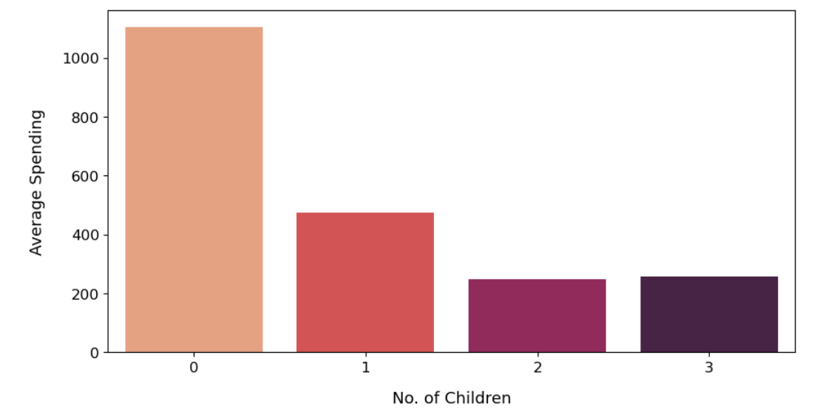
Average Spendings: Child Status Wise
- Customers who do not have children at home spend more than customers who have 1 child.
- Customers having 1 child spend higher than customers having 2 and 3 children.

Slide 12
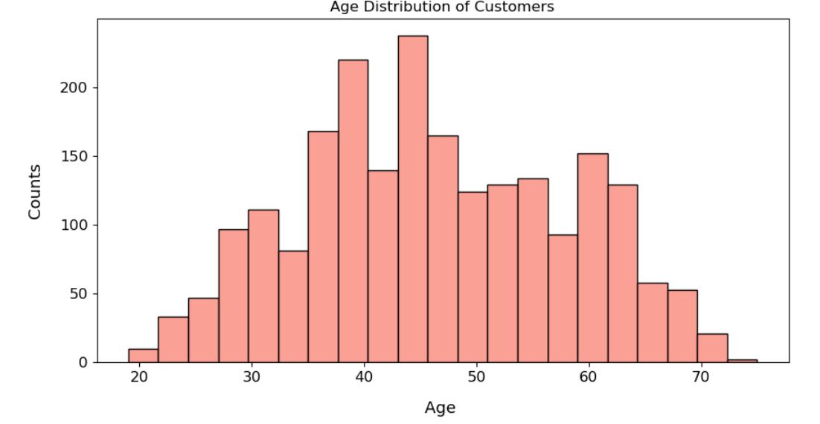
Age Distribution of Customers
Customer ages are nearly normally distributed, with most customers between 40 and 60 years old.

Slide 13
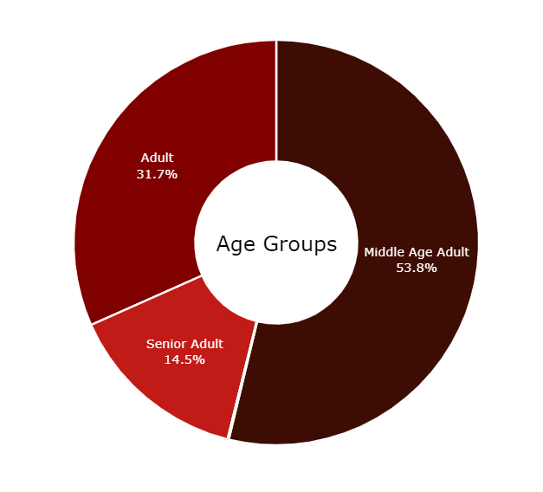
Customers Segmentation: Age Group Wise
- More than 50% of customers are Middle Age Adults between 40 and 60
- The 2nd notable age category is Mature, aged between 20 and 40

Slide 14
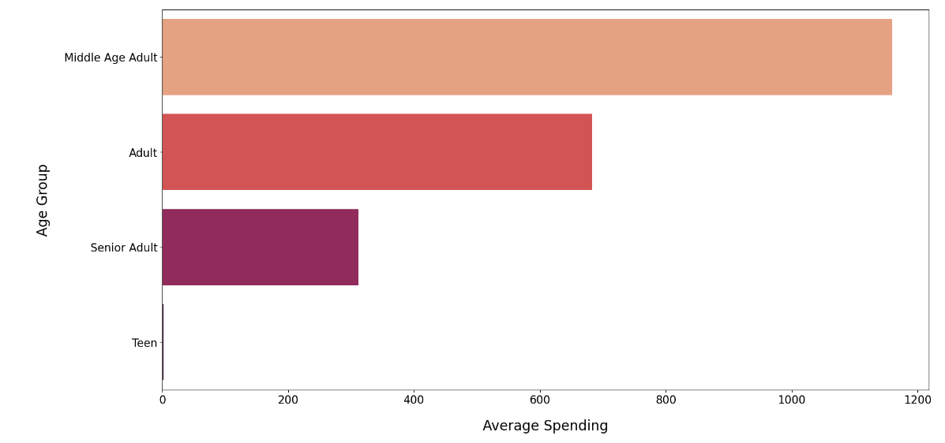
Average Spendings: Age Group Wise
Middle-aged adults spend more than any other age group.

Slide 15
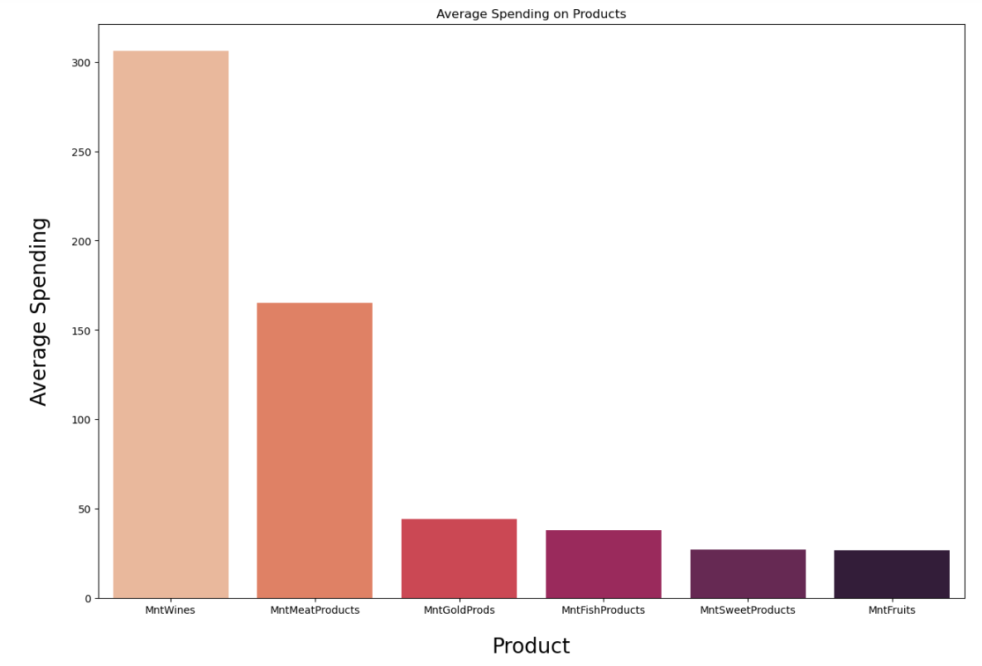
Most Bought Products:
- Wine and Meat Products are the most famous products among customers
- Candies and Fruits are not purchased often

Slide 16
Conclusion:
- Most of the customers are university graduates
- Most customers live with partners
- Those who live alone have spent more than those who live with a partner
- Most customers have only one child
- Those who have no children have spent more
- Middle Age Adults, aged between 40 and 60 years, is a well-known age group category
- Middle-aged adults spend, on average, more than any other age group
- Most of the customers earn between 25000 and 85000
- Wine and Meat Products are very famous among customers

Slide 17
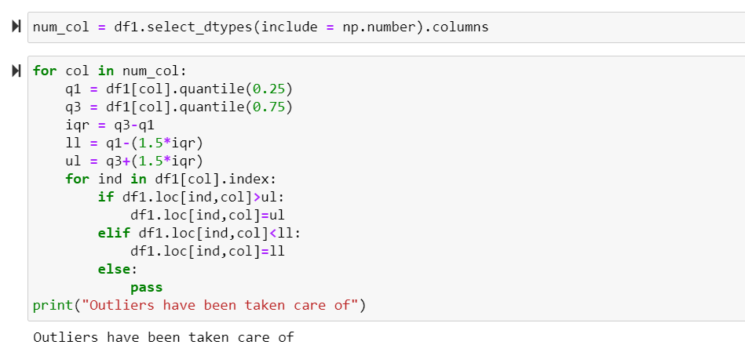
Let's use capping technique to treat outliers

Slide 18
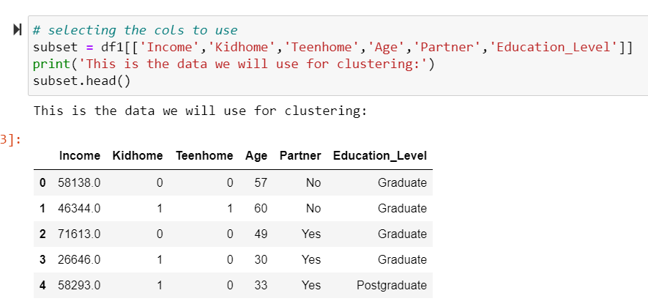
FEATURE TRANSFORMATION (This is the data we will use for clustering)

Slide 19
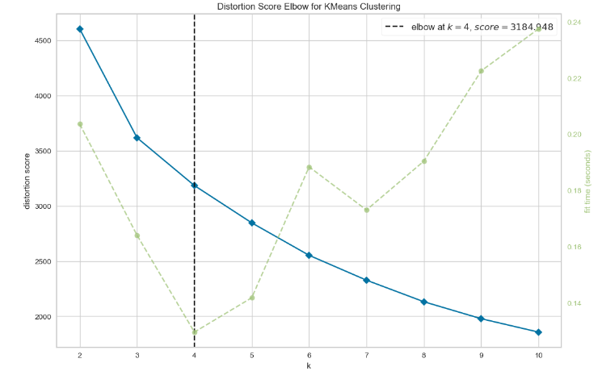
K-MEANS CLUSTERING & CLUSTER's ANALYSIS Optimum Clusters Using Elbow Method

Slide 20
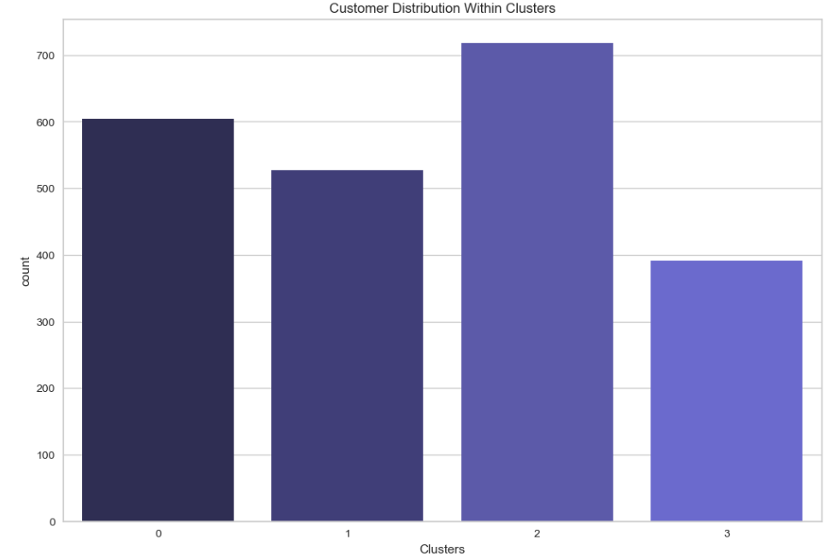
Customer Distribution Within Clusters
Observations 👀
1. Cluster 2 has highest number of customers
2. Cluster 3 has least number of customers

Slide 21
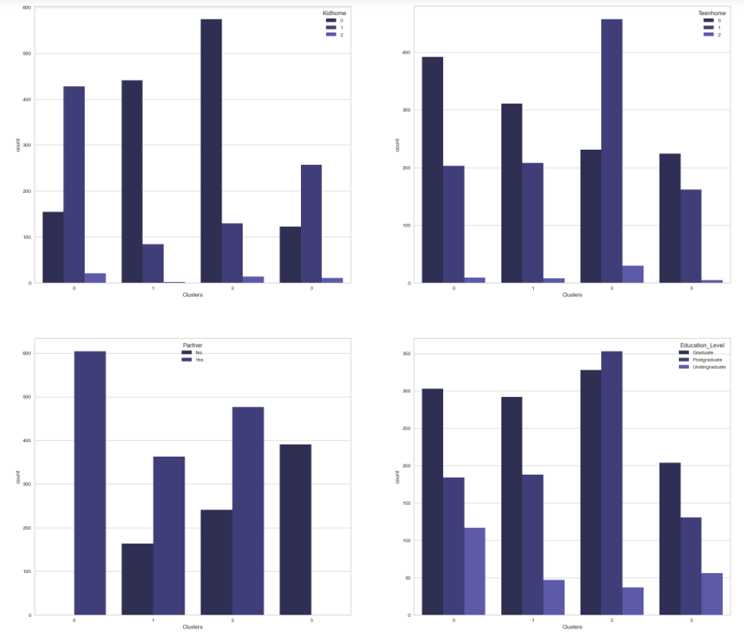
number of customers in each cluster have how many Kids or Teens in household, how many of them have partner and their education level

Slide 22
Observations 👀
Kidhome:
* Cluster 0 mostly has customers with 1 kid in household
* Cluster 1 has customers with no kids in household
* Cluster 2 also has large number of customers with no kids in household
* Cluster 3 has customers with 0 and 1 kids in household
Teenhome:
* Cluster 0 consist of customers with no teen in household & few of them have 1 Teen in household
* Same goes for the cluster 1 & 3
* Cluster 2 has customers with 1 Teen in household
Partner:
* All the customers in cluster 0 have partner
* All The customers in cluster 3 have no partner
* Cluster 1 & 2 has customers with and without partner, but most of them have partner
Education_Level:
* All clusters have customers with graduate, postgraduate and undergraduate background
* All clusters have less number of customers with undergraduate background
* Cluter 2 has highest number of postgraduates and graduates

Slide 23
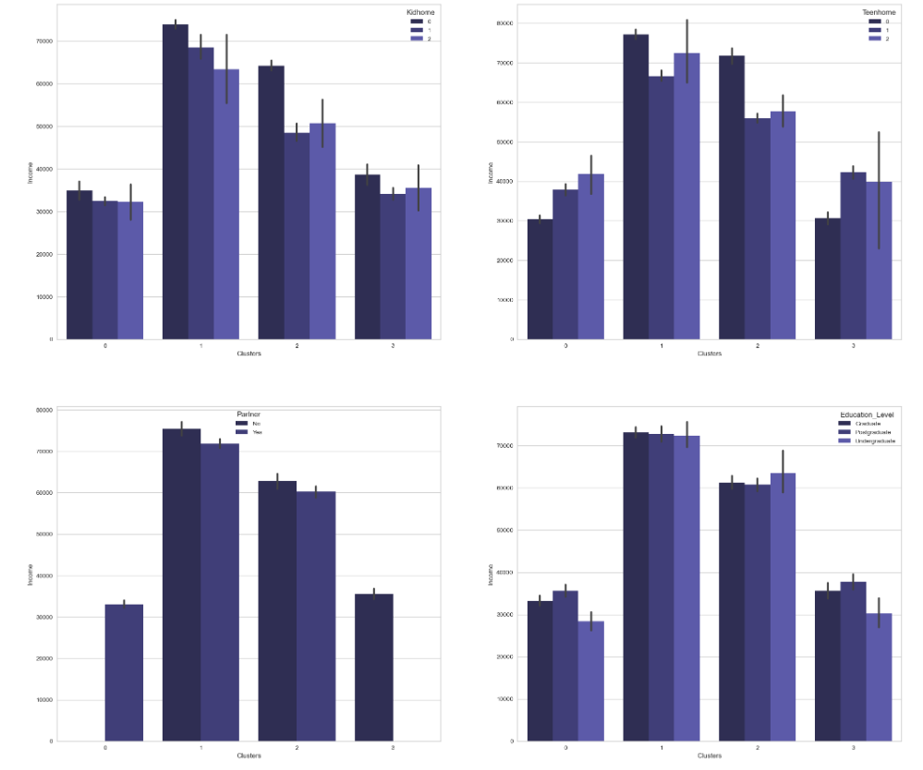
contributing factors in income

Slide 24
Observations 👀
Cluster 1 Cluster 0
- fewer customers but with the highest income - Least income
- No kids, few have 1 teen - 1 kid & few have 1 Teen also
- Graduates & postgraduates - Graduates & postgraduates but also has most
- Most of them have partner undergraduates than any cluster
- All have partner
Cluster 2
- Max number of customers & high income Cluster 3
- No kids, few have 1 or 2 Teen - fewer customers & less income
- High number of postgraduates & graduates - 1 kid & few have 1 Teen also
- Most of them have partner - Graduates & postgraduates
- All have no partner

Slide 25
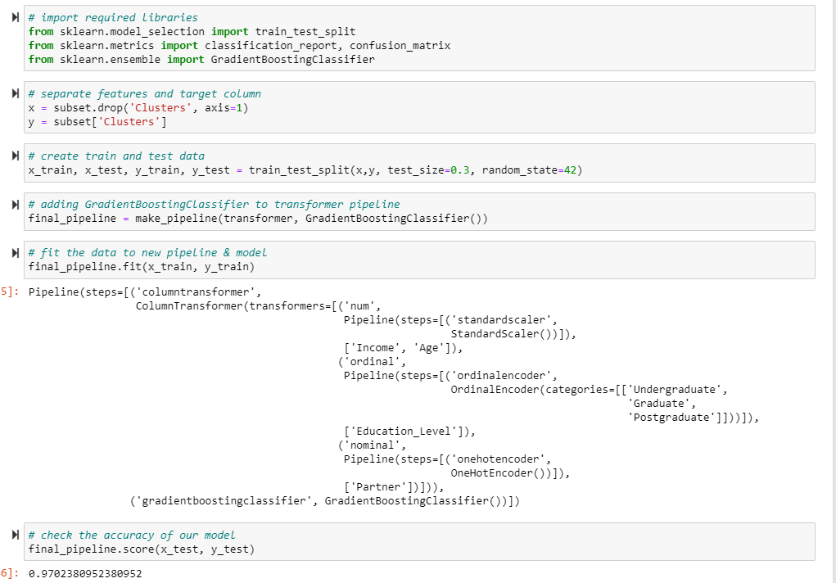
Now lets build a multi classification model that will predict the cluster for given input of perticular customer

Slide 26
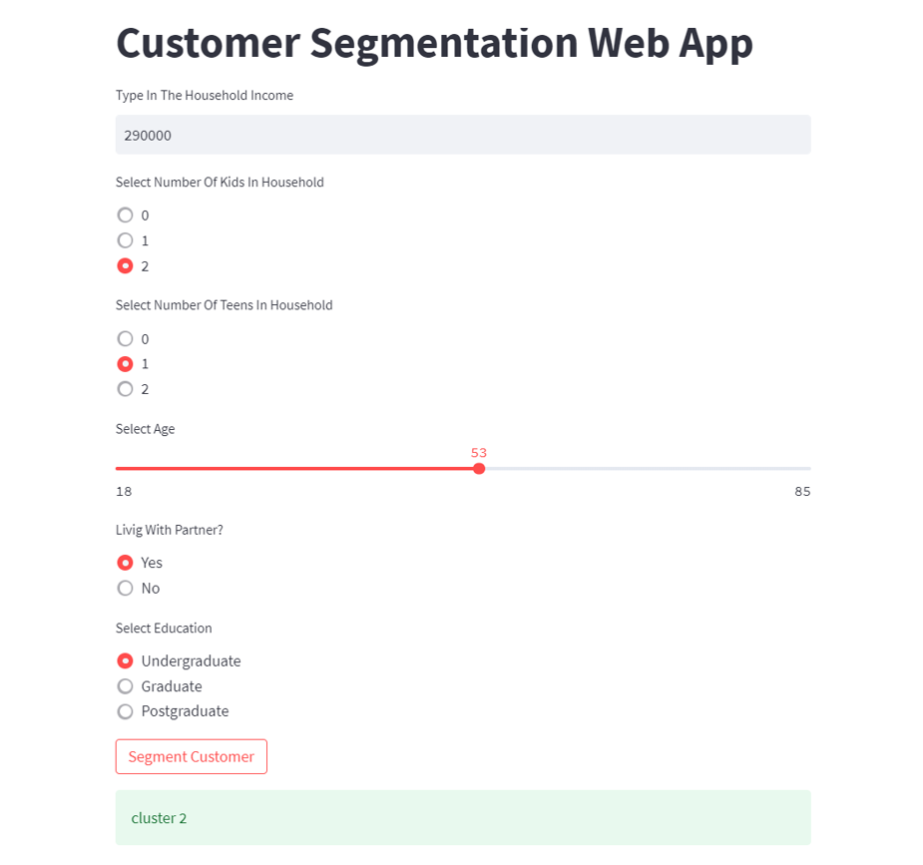
The deployed streamlit model opens in website from and look like:

Slide 27
What are the challenges of clustering?
The cluster membership may change over time due to dynamic shifts in data.
Handling outliers is difficult in cluster analysis.
Clustering struggles with high-dimensional datasets.
Multiple correct answers for the same problem.
Evaluating a solution’s correctness is problematic.
Clustering computation can become complex and expensive.
Assumption of equal feature variance in distance measures.
Struggle with missing data (columns and points)

Slide 28

Thank You

